Slide 1
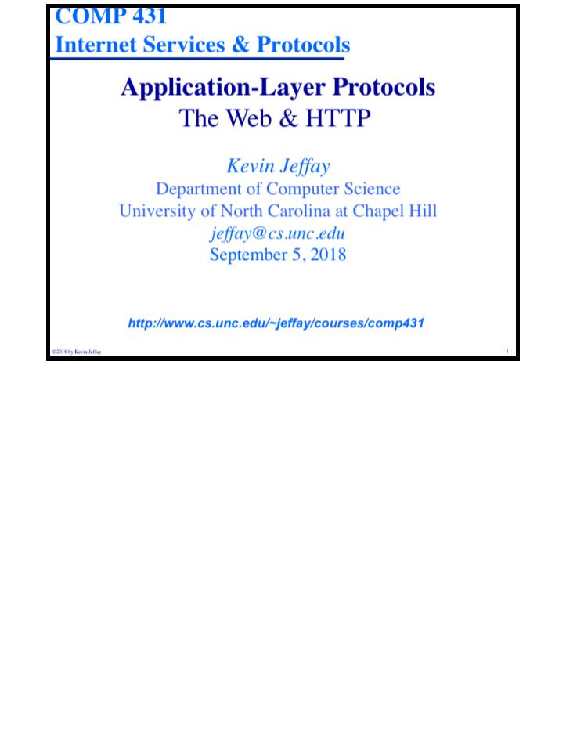
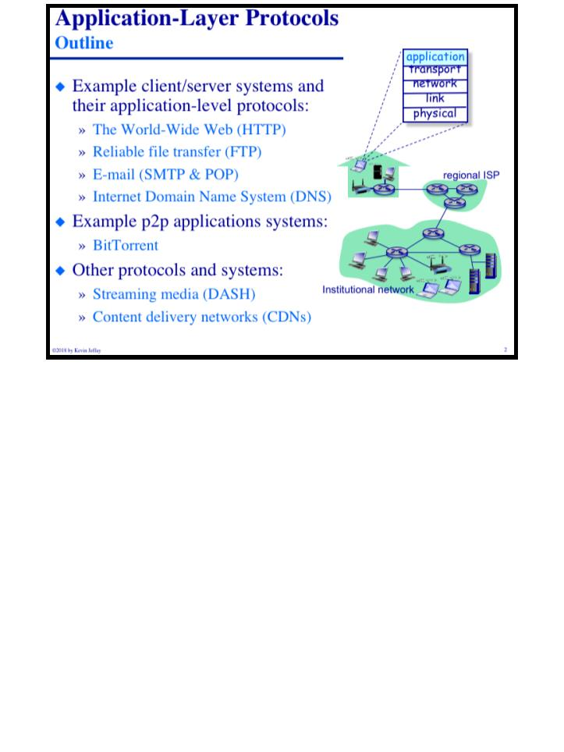
Printed on Tuesday, September 4, 2018 at 8:33 AM.
COMP 431
© 2018 by Kevin Jeffay
Lecture 4, The Web & HTTP
COMP 431
© 2018 by Kevin Jeffay
Lecture 4, The Web & HTTP
September 5, 2018
September 5, 2018
Page 1
Page 2

Slide 2
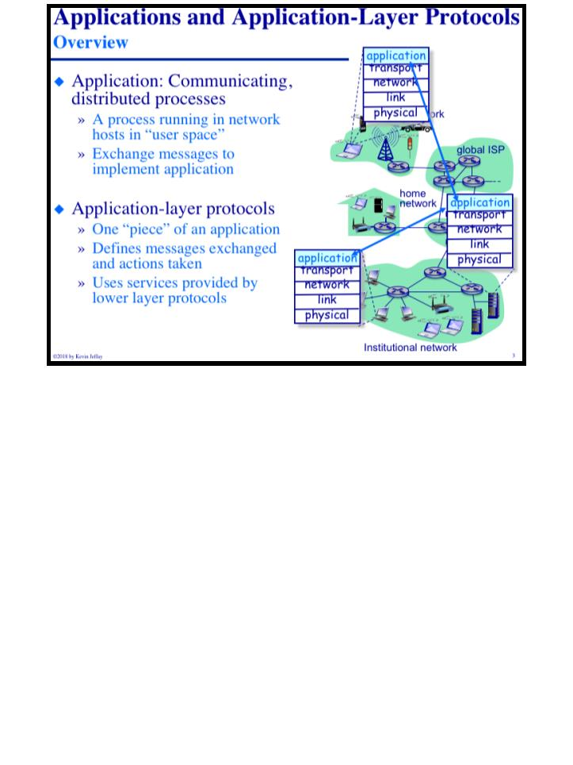
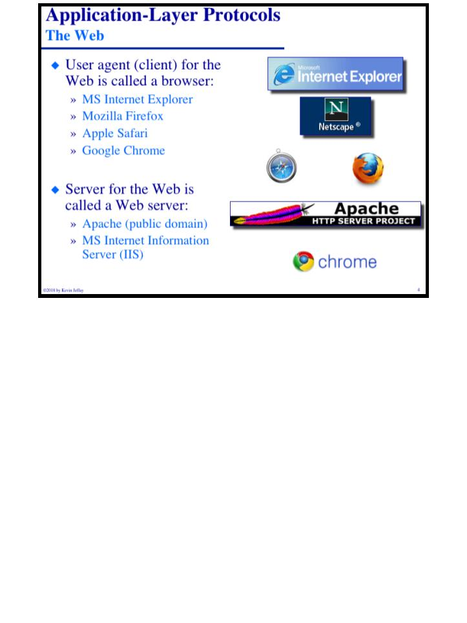
COMP 431
Lecture 4, The Web & HTTP
September 5, 2018
COMP 431
© 2018 by Kevin Jeffay
Lecture 4, The Web & HTTP
September 5, 2018
© 2018 by Kevin Jeffay
Page 3
Page 4

Slide 3
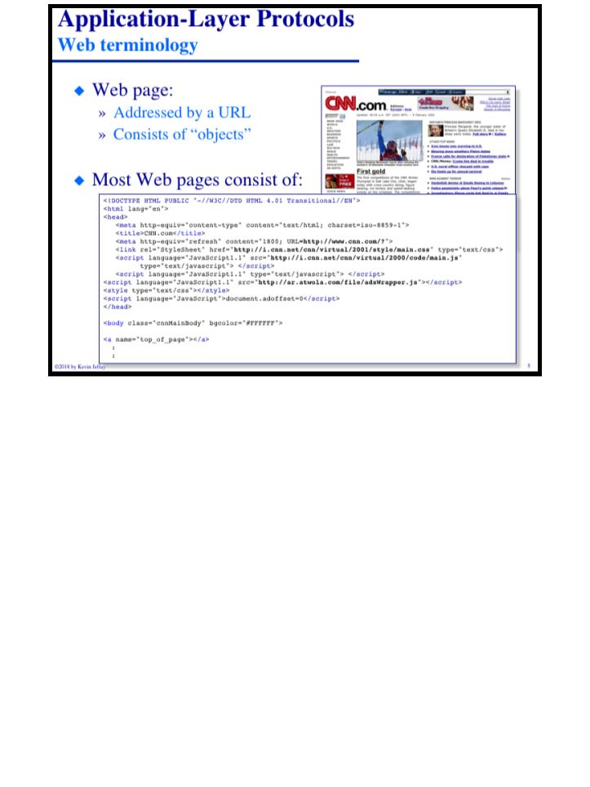
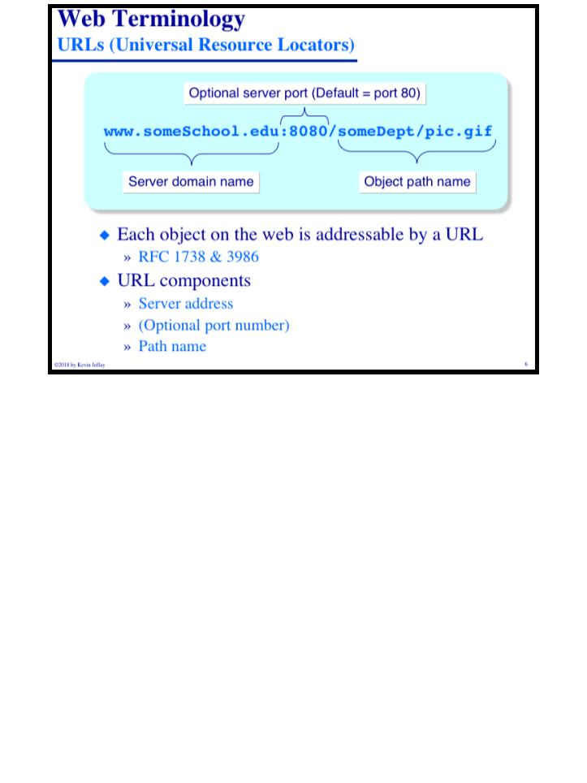
COMP 431
Lecture 4, The Web & HTTP
September 5, 2018
COMP 431
© 2018 by Kevin Jeffay
Lecture 4, The Web & HTTP
September 5, 2018
© 2018 by Kevin Jeffay
Page 5
Page 6

Slide 4
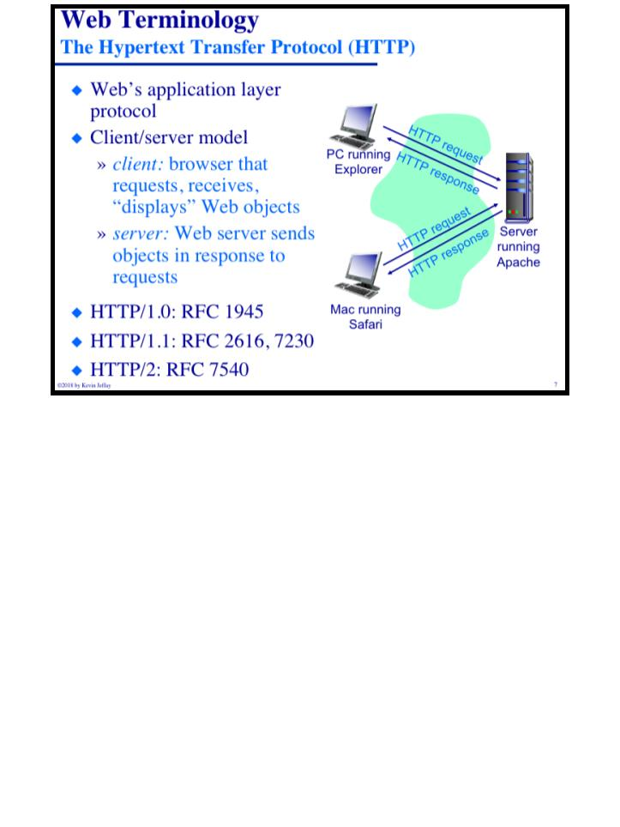
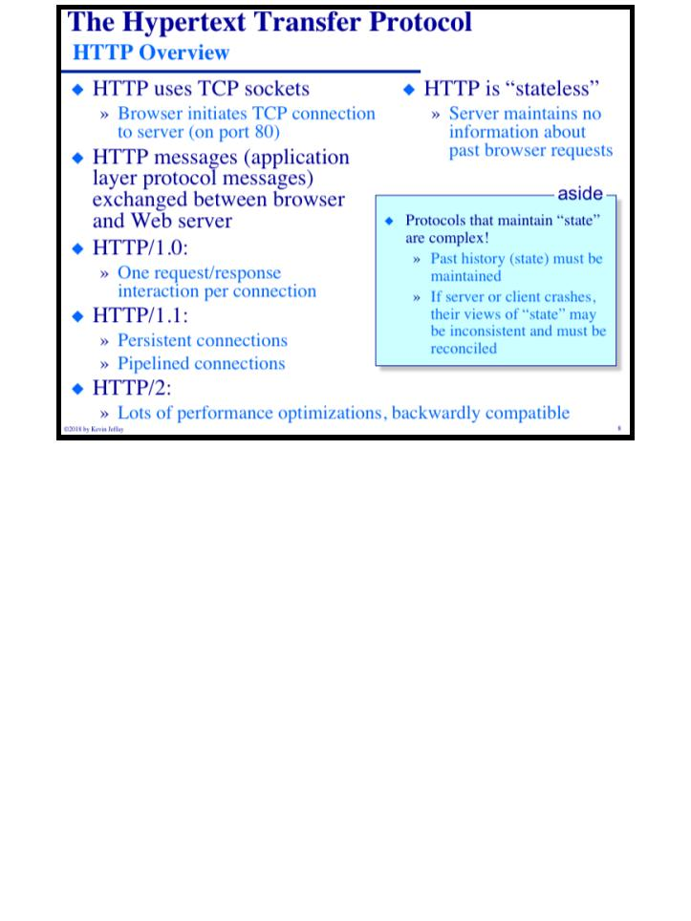
COMP 431
Lecture 4, The Web & HTTP
September 5, 2018
COMP 431
© 2018 by Kevin Jeffay
Lecture 4, The Web & HTTP
September 5, 2018
© 2018 by Kevin Jeffay
Page 7
Page 8

Slide 5
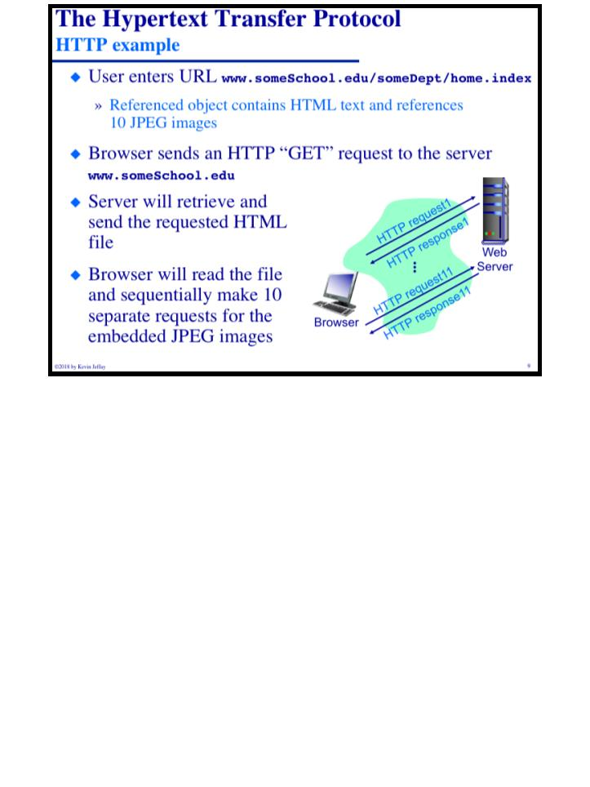
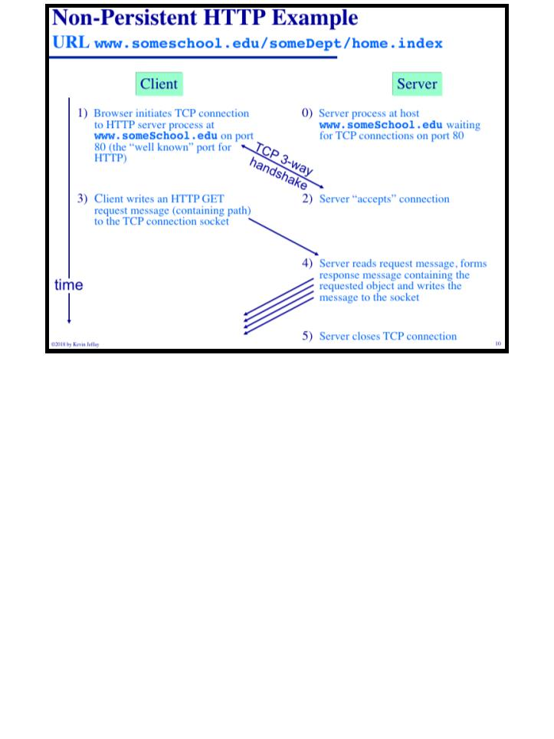
COMP 431
Lecture 4, The Web & HTTP
September 5, 2018
COMP 431
© 2018 by Kevin Jeffay
Lecture 4, The Web & HTTP
September 5, 2018
© 2018 by Kevin Jeffay
Page 9
Page 10

Slide 6
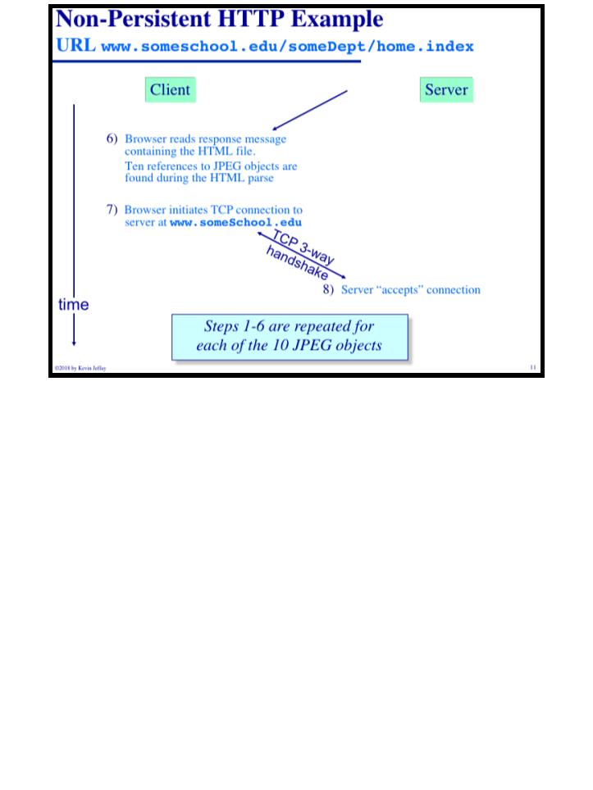
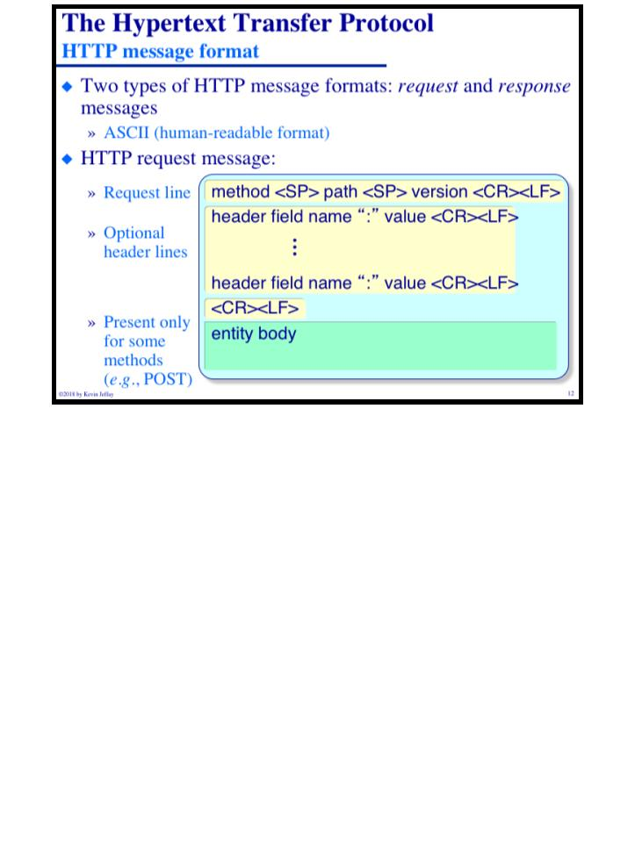
COMP 431
Lecture 4, The Web & HTTP
September 5, 2018
COMP 431
© 2018 by Kevin Jeffay
Lecture 4, The Web & HTTP
September 5, 2018
© 2018 by Kevin Jeffay
Page 11
Page 12

Slide 7
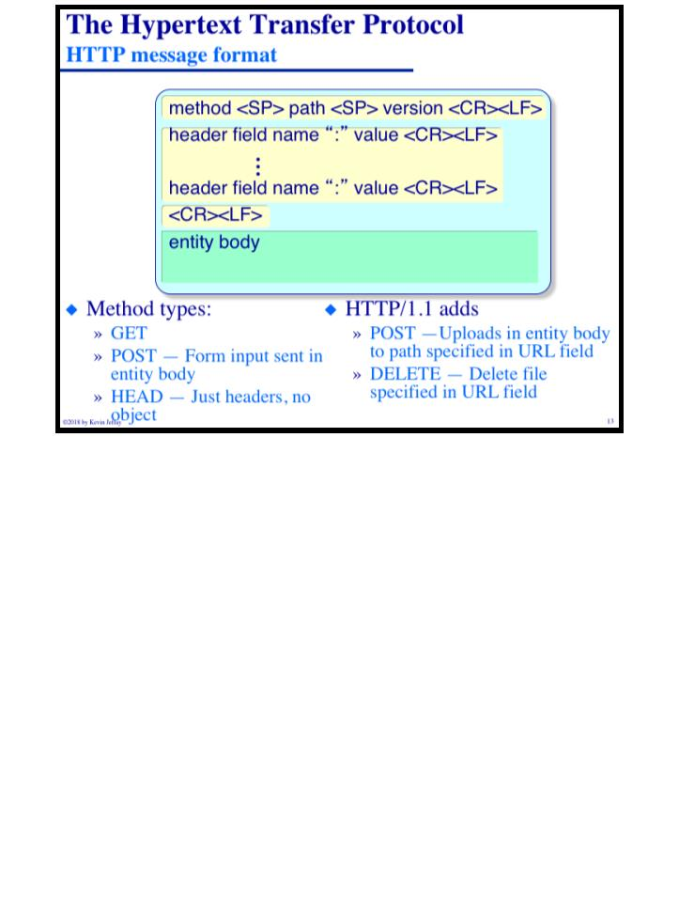
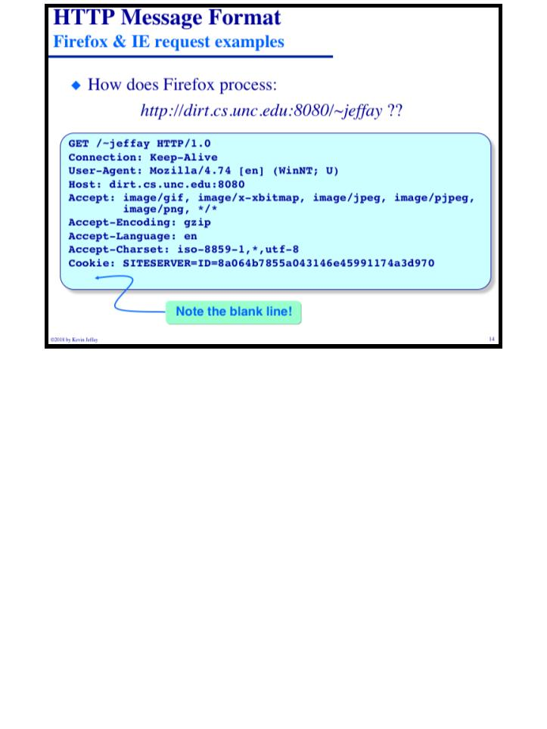
COMP 431
Lecture 4, The Web & HTTP
September 5, 2018
COMP 431
© 2018 by Kevin Jeffay
Lecture 4, The Web & HTTP
September 5, 2018
© 2018 by Kevin Jeffay
Page 13
Page 14

Slide 8
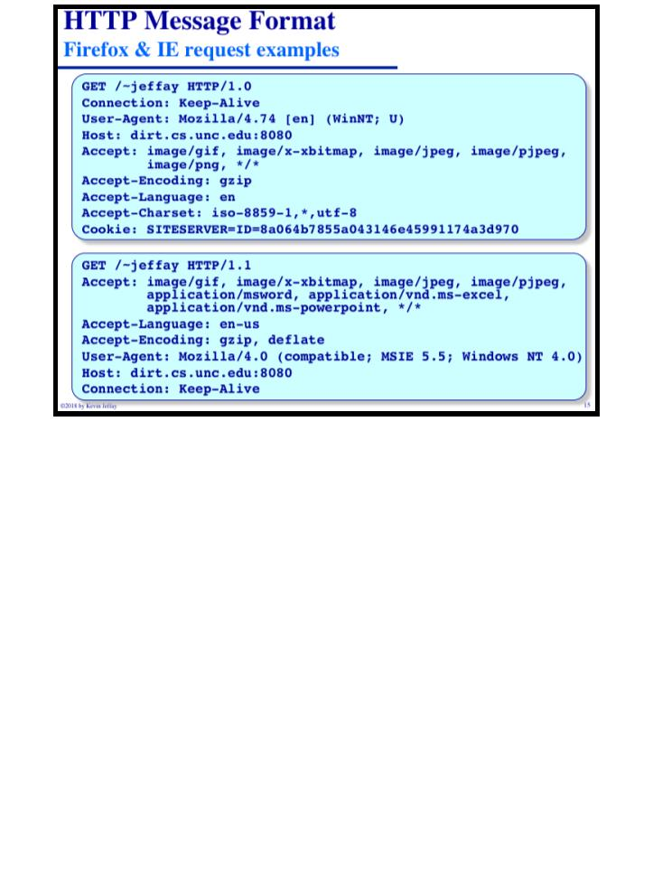
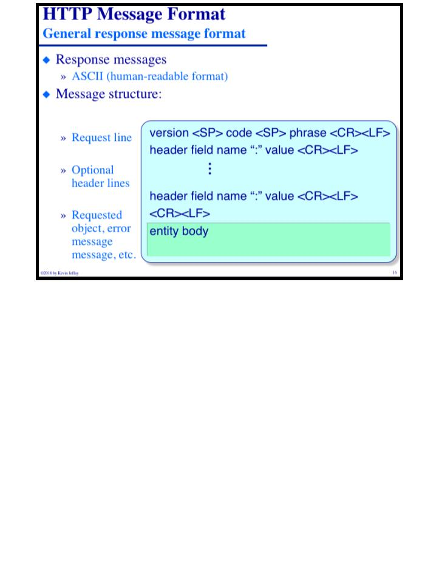
COMP 431
Lecture 4, The Web & HTTP
September 5, 2018
COMP 431
© 2018 by Kevin Jeffay
Lecture 4, The Web & HTTP
September 5, 2018
© 2018 by Kevin Jeffay
Page 15
Page 16

Slide 9
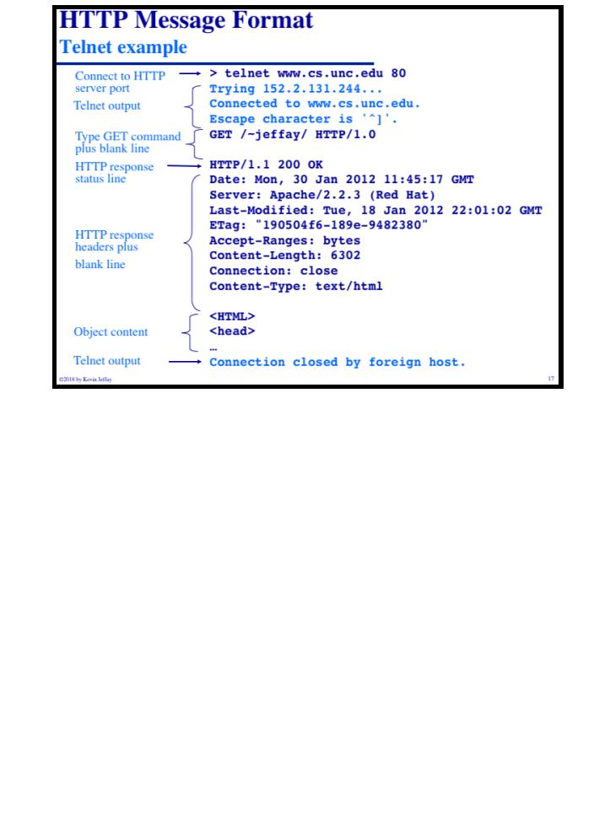
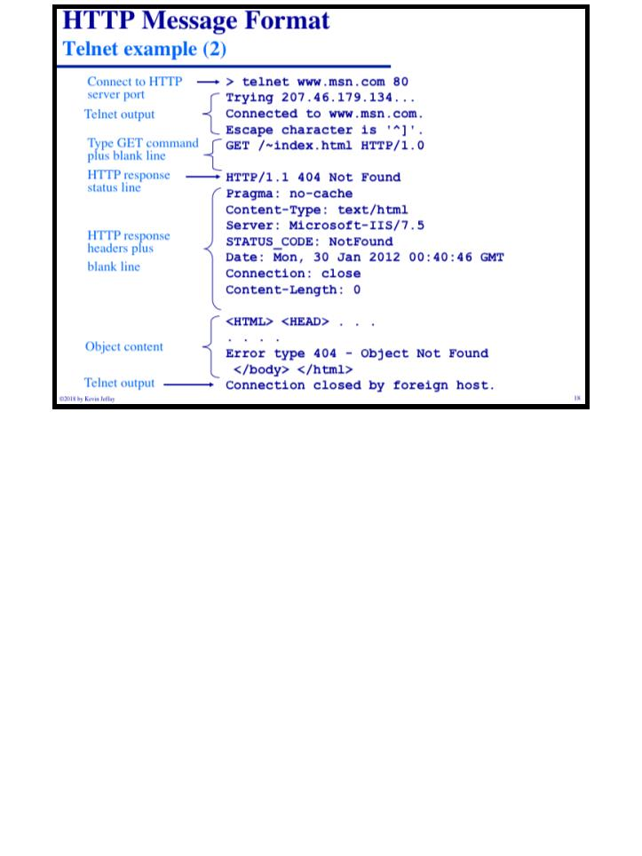
COMP 431
Lecture 4, The Web & HTTP
September 5, 2018
COMP 431
© 2018 by Kevin Jeffay
Lecture 4, The Web & HTTP
September 5, 2018
© 2018 by Kevin Jeffay
Page 17
Page 18

Slide 10
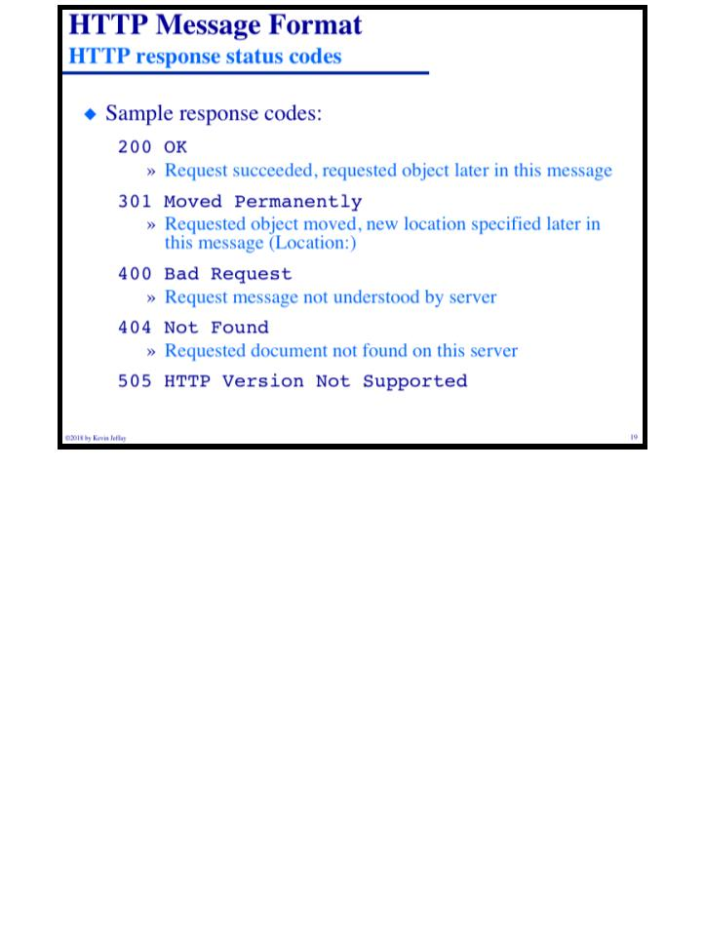
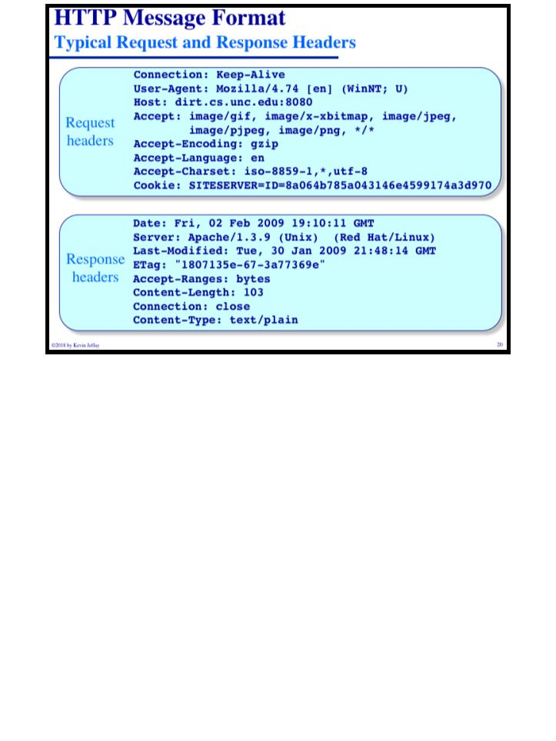
COMP 431
Lecture 4, The Web & HTTP
September 5, 2018
COMP 431
© 2018 by Kevin Jeffay
Lecture 4, The Web & HTTP
September 5, 2018
© 2018 by Kevin Jeffay
Page 19
Page 20

